Slide 1
ASSIGNMENT DESIGN AND SCAFFOLDING
CARLA REYES
LINDA WEAVER

Slide 2
LIFE. DISCUSS.
AS A PROMPT, THIS COULD USE A BIT OF REVISION!

Slide 3
WHAT ARE THE QUALITIES OF “GOOD WRITING”?
Consider the specific skills/characteristics you are hoping your students will demonstrate in their writing. Include critical thinking, knowledge display, essay structure and organization, grammar, vocabulary, use of sources, etc.

Slide 4
HOW DO STUDENTS PERFORM COMPARED TO THIS LIST? (FIRST, GENERAL POPULATION)
1 5 10
Not even close Got the basic idea Exceeded
Expectations

Slide 5
HOW DO STUDENTS PERFORM COMPARED TO THIS LIST? (MULTILINGUAL STUDENTS)
1 5 10
Not even close Got the basic idea Exceeded
Expectations

Slide 6
IN WHAT WAYS DO STUDENTS UNDERPERFORM?

Slide 7
WHY ARE STUDENTS UNDERPERFORMING?
Be a detective.

Slide 8
PERFORMANCE DISCREPANCY MODEL
The Performance Discrepancy Model on the next slide can be used in many contexts (business, education, etc.) to determine why an individual may not be performing up to expectations.
This identification can then be used to remedy the discrepancy.

Slide 9
PERFORMANCE DISCREPANCY MODEL
1. Is the performance important? No: Drop
(Pick your battles!) Yes: Continue
2. Has the expectation been clearly communicated?
No: Communicate expectation clearly (who is to do it, what is to be done, when, how?)
Yes: Continue
3. Is nonperformance due to a medical condition? Yes: Treat medical condition.
(e.g. depression, ADHD, etc.) No: Continue
4. Is nonperformance due to a lack of skill? Yes: Teach the skill
(e.g. social skills, anger management) No: Continue
5. Is nonperformance due to a lack of resources? Yes: Provide resources
(e.g. lack of finances, time, equipment) No: Continue
6. Is nonperformance due to a lack of cultural knowledge? Yes: Remedy????!!!?!?!!?!!!?
(e.g. lack of background knowledge, outsider status)

Slide 10
WRITING DISCREPANCY MODEL
In the same way, we need to determine why individual students are not performing up to expectations. Many different reasons may contribute to students’ underperforming.
Do they not understand the assignment/expectations?
Do they not understand the vocabulary?
Do they not have necessary background knowledge or cultural understanding?
Do they not have an understanding of the academic system, for example, acceptable quoting, paraphrasing, and citations?

Slide 11
COUNTING VOWELS ACTIVITY
In the workshop, we did an activity from Saundra Yancy McGuire’s book, Teach Students How to Learn. Participants were given a list of words and instructed to count all the vowels in a short time span. After time was called and participants turned the page over so that they could not see the list, participants were asked to write down as many words on the list as they could remember.
Predictably, performance was not as high as anyone would have liked.
The activity has a second part and illustrates several aspects of learning and teaching, but this first part as described is most relevant to this presentation.

Slide 12
HOW DID YOU FEEL DURING THE FIRST ROUND WHEN I SAID, “LIST THE WORDS”?
Our students may similarly feel frustrated and feel as though what was expected of them did not match our instructions, even though we may be trying hard to be clear, explicit, and transparent in our communication.

Slide 13
WHAT IS OUR TARGET/OUR STUDENTS’ TARGET?
“Like culture, ‘academic writing’ is a social practice that does not yield to definitions” (Macbeth, 2006,“Diverse, Unforeseen, and Quaint Difficulties”).

Slide 14
“ACADEMIC WRITING”
Lack of clear definition
Extremely culturally grounded
“Locally enacted” (Macbeth, 2006)
By discipline and by professor

Slide 15
EXAMPLES OF CULTURAL CONVENTIONS
Thesis statements
Argument
Summaries
Plagiarism
Citations
(Adapted from Macbeth, 2006)

Slide 16
WHAT COMES FIRST?
We see a good student paper as a “consequence of having followed the instructions” but being able to follow the instructions depends on understanding what a “good paper” means in the first place.
(Macbeth, 2006 and 2009)

Slide 17
IN OTHER WORDS, YOU HAVE TO KNOW WHERE YOU ARE GOING BEFORE YOU CAN USE THE MAP.
THEN WHAT’S THE POINT OF A MAP?

Slide 18
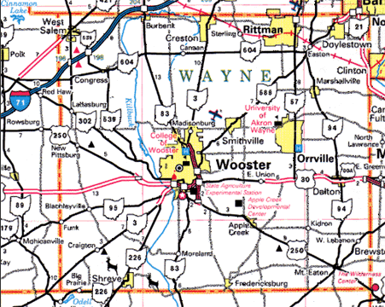
We use maps to get us to places with which we are unfamiliar.

Slide 19
A map in an unfamiliar language will be much harder to use effectively.

Slide 20
In order to read a blueprint, we need a tremendous amount of prior knowledge. A novice will not be able to interpret this image. Unfortunately, many of our assignments may be more blueprint than road map for our multilingual students.

Slide 21
NAVIGATING ACADEMICS
Students will take instructions literally when faced with unfamiliar tasks.
(Macbeth, 2006)

Slide 22
ASSIGNMENT DESIGN

Slide 23
ASSIGNMENT DESIGN
It’ll never be perfect.

Slide 24
ASSIGNMENT DESIGN
Six types of variables explained by Kroll and Reid
The six variables and many of the explanatory details on the following slides are taken from Kroll and Reid, 1994. These are intermingled with our comments & questions to help you think through your assignments.
See the “Faculty Resource: Assignment Review” file on this site for an activity that takes you through a review of an assignment based on these six variables.

Slide 25
1. THE WRITING SITUATION – CONTEXTUAL VARIABLES
Discipline
Specific course
Placement exams
Graduation requirements

Slide 26
THE WRITING SITUATION – CONTEXTUAL VARIABLES
Where does this writing assignment come in the course? (Beginning of semester, first of series of writing assignments, major paper instead of a final exam, etc.)
How is this writing assignment used in this course? What are the stakes for the students? (Is successful completion of this paper necessary to pass the course?)
What does this writing assignment accomplish in the course – how does it connect to course objectives, course content, etc.?

Slide 27
2. THE SCORING CRITERIA – EVALUATION VARIABLES
Awareness of your own grading values
Communication with students

Slide 28
THE SCORING CRITERIA – EVALUATION VARIABLES
What are your highest values in grading? Think through what you really want to see from students.
Do you use a rubric that clearly expresses the values you identified above?
How have you communicated your scoring expectations to students?
When do students find out your grading expectations? Do you give them the rubric with the assignment?

Slide 29
3. THE RHETORICAL SPECIFICATIONS – RHETORICAL VARIABLES
Persona-voice; audience; purpose
Rhetorical patterns, for example . . .
Compare/Contrast
Cause/Effect

Slide 30
STUDENTS MAY NOT KNOW DIFFERENT GENRES OR RHETORICAL PATTERNS
“On consideration, there is no reason to expect that these novices would know the distinction between an essay, interview, news article, or legal tract” (MacBeth, 2006).

Slide 31
THE RHETORICAL SPECIFICATIONS – RHETORICAL VARIABLES
What rhetorical patterns/devices are you asking students to use?
How are you asking for that rhetorical pattern?
Are you explicitly naming the pattern?
Are you describing or explaining the pattern?
How much background knowledge must students have to make sense of this expectation?

Slide 32
4. THE TASK – TASK VARIABLES
Consider the number and complexity of tasks required to complete any single assignment. (avoid overload)
Consider the types of thinking required to successfully complete the assignment.

Slide 33
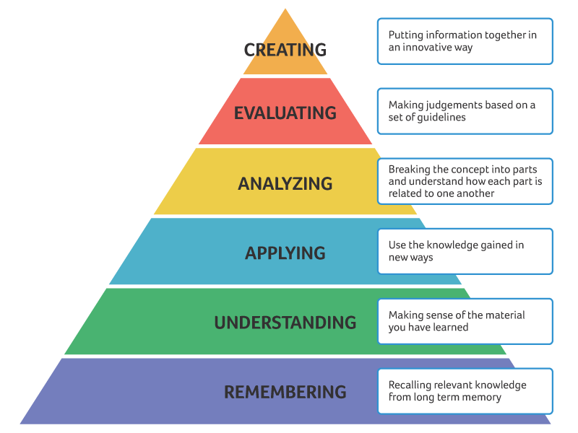

Slide 34
WRITING EXPECTATIONS – IS YOUR TARGET KNOWLEDGE DISPLAY OR TRANSFORMATION?
Knowledge display
Knowledge transformation
Analysis
Argumentative
“Research”

Slide 35
KNOWLEDGE DISPLAY
What many students are used to doing with writing in high school
Many education styles in other countries – and in U.S. - strongly emphasize memorization and exact repetition of knowledge

Slide 36
KNOWLEDGE DISPLAY
Professors may hope for knowledge transformation and students interpret the prompt as a request for knowledge display.
Midterm essay prompt:
Integrating course materials, create a conversation between the 3 leaders we’ve studied, making mention of relevant life experiences and community impacts.
Student comment: “I know that the professor needs to check that I’ve done the readings and assigned homework. So, I understand that I have to put citations. But…”
Prompt to describe family background/upbringing
Student comment: “Well…what we understand it to be about is to talk more about the ideas from class.”

Slide 37
WHAT IS ANALYSIS?

Slide 38
ANALYSIS
Instructors told students to use more analysis but did not define it!
(Macbeth, 2006)

Slide 39
WHAT IS ANALYSIS?
What is analysis?
Re-organization of information in some original way for the purposes of the discipline / text
Categorization
Looking from a disciplinary lens
Identification of which lenses and/or constructs students should prioritize in their reporting and explaining information
Pessoa, S., Mitchell, T. D., Gomez-Laich, M. P., Maune, M., & Miller, R. T. (2019). Scaffolding student argumentative writing across the disciplines through explicit instruction. Atlanta, GA: TESOL 2019 International Convention.

Slide 40
DESCRIPTION AND ANALYSIS
Help students understand how to use description in the service of or as a set-up for analysis.
(Humphrey & Economou, 2015)

Slide 41
ARGUMENTATION
Typically follows a claims-grounds pattern
Analysis is used in the service of an argument
Prompt words that are likely to result in an opinion are most likely to lead to argumentative
Explicitly and repeatedly include words indicating logical relations
Miller, R. T., Mitchell, T. D., Pessoa, S. (2016). Impact of source texts and prompts on students’ genre uptake. Journal of Second Language Writing, 31, 11-24.

Slide 42
5. THE SUBJECT MATTER – CONTENT VARIABLES
Course content vs. other content
What background knowledge is required to navigate the assignment?
Is the content within the experience of the student?
What cultural interference can lead to different interpretations?

Slide 43
WHAT DO YOU MEAN BY “VOWEL”? WHAT KIND OF VOWEL?

Slide 44
When Linda first presented the Counting Vowels activity to Carla, Carla exclaimed, “Wait! What do you mean by ‘vowel’? What kind of vowel?”
As a linguist, she had background knowledge that required more information before she could complete the task of “counting vowels.”
The opposite is also true. We discussed how this activity would work with a group of non-native English speakers because they might not know the word “vowel” at all. We made sure to define the word before we began the activity.

Slide 45
THE SUBJECT MATTER – CONTENT VARIABLES
“Peer Pressure” – this term proved incomprehensible to students from community-oriented cultures (Kroll and Reid, 1994).
Noise Complaint – one prompt required students to write a complaint about noise from a neighbor’s gathering. The students said that in their culture, they wouldn’t complain – they would “want to join the party” (Kroll and Reid, 1994).

Slide 46
CONTENT VARIABLES
What other skills does the student need to complete the assignment?
Research
Citation
Knowledge of annotated bibliography, etc.

Slide 47
6. THE WORDING OF BOTH THE PROMPT AND THE INSTRUCTIONS – LINGUISTIC VARIABLES
Words that have multiple meanings
Words that are inaccessible to multilingual writers for cultural or skill reasons

Slide 48
LINGUISTIC VARIABLES
“Concrete details” – when a prompt asked students to use “concrete details,” some students wrote about construction and making concrete (as in cement) (Kroll and Reid, 1994).

Slide 49
LINGUISTIC VARIABLES
Linda worked with a student who wrote a practice essay to the following prompt that she pulled from a GRE prep book: “To understand the most important characteristics of a society, one must study its major cities.”
As we discussed her response, she became frustrated and exclaimed, “What do they mean by ‘study’!? Do they mean looking at pictures of the city in books? Do they mean visiting as a tourist? Do they mean living there and getting to know the people?”
Although the prompt appeared to be straightforward, this student noted that the seemingly simple word “study” could indeed be interpreted in multiple ways that would significantly affect the student’s response.

Slide 50
These six variables can also intersect to create difficulties for students.

Slide 51
TASK AND LINGUISTIC VARIABLES COLLIDING!
Use vocabulary that will cue the cognitive tasks that are your target.
Bloom’s Taxonomy Action Verbs (This can be found via an online search.)

Slide 52
RHETORICAL AND LINGUISTIC VARIABLES COLLIDING!
“Choice of specific ‘cuing words’ in writing test prompts also will lead students to invoke different rhetorical strategies”
(Kroll & Reid, 1994).

Slide 53
MAKE LINGUISTIC CHOICES THAT ELICIT YOUR TARGET RESPONSE.
Use of second person “you” elicits more argumentative writing.
Use of information questions is more likely to elicit knowledge display writing
Miller, R. T., Mitchell, T. D., Pessoa, S. (2016). Impact of source texts and prompts on students’ genre uptake. Journal of Second Language Writing, 31, 11-24.

Slide 54
MORE TIPS
Avoid a list of questions to prompt thinking.
“Am I supposed to answer all of these?”
Confuses students’ attempts to organize writing

Slide 55
CULTURAL CONSIDERATIONS
Many students have only been asked for knowledge display in their previous academic experience.
Argumentation/claim may be considered unacceptable for a “novice” or a learner/student.
Fordesen, J., Gough, J., & Lashmet, A. (2019, March 13). International students writing across the curriculum: Investigating prompts and interactions. Atlanta, GA: TESOL 2019 International Convention.

Slide 56
A POSSIBLE COMPROMISE
Offer an Ideal/Creative Option and a Play-it-Safe Option
This will allow students the freedom to choose a more creative approach to an assignment but will also give students who may be overwhelmed by a new academic culture a more familiar writing structure so that they can focus on the other tasks required by the assignment.

Slide 57
EXAMPLE OF REWRITTEN PROMPT
Possible prompt being responded to?
Explain the effect of the competition system on employee behavior. (Mostly KD, not KT)
Possible optimally-designed prompt could be…
Based on what we have learned about socialization, organizational culture, workplace environment, and performance, do you think the competition-driven system is beneficial for organizations? Provide examples of how competition affected the above aspects either positively or negatively in cases that we’ve studied to support your argument. (KT prompted, Argumentation prompted)

Slide 58
EXAMPLE FROM LINDA’S OFFICE
Linda worked with an international student on an assignment for an Annotated Bibliography.
The assignment gave detailed expectations, but it assumed knowledge of what an Annotated Bibliography is. As Linda worked with the student, she became aware of the long list of prior knowledge that the student needed to navigate this assignment (blueprint):
What an acceptable academic source is
How to find academic sources/how to navigate our campus library, either on-line or in person
How to paraphrase/quote according to U.S. academic integrity expectations
How to create in-text citations and a Works Cited page
The format of an Annotated Bibliography
The expectations for the annotations (content and critical analysis)
All of this is merely the background knowledge of U.S. academics that the student needed. The student also needed the language skills to read, understand, and analyze the sources and then to write the annotations.

Slide 59
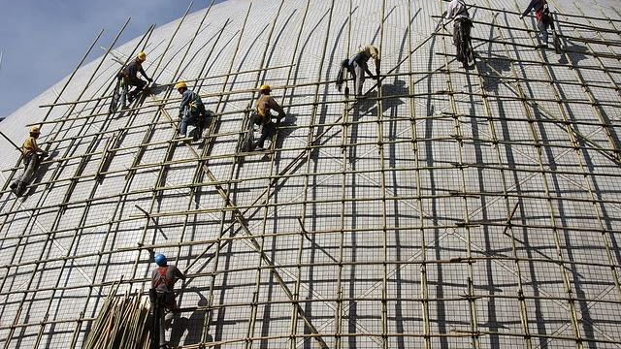
WHAT IS SCAFFOLDING?
This Photo by Unknown Author is licensed under CC BY-SA-NC

Slide 60
“SUPPORT IS TAILORED TO LEARNERS’ CURRENT LEVELS OF COMPETENCE, TASKS ARE WITHIN THEIR CAPABILITIES, LEARNERS ARE ACTIVE CONTRIBUTORS, THERE IS GENUINE COLLABORATION BETWEEN THE TEACHER AND LEARNERS, AND SUPPORT IS GRADUALLY WITHDRAWN AS COMPETENCE DEVELOPS.”
(Wette, 2015)

Slide 61
HOW MULTILINGUAL STUDENTS BENEFIT FROM SCAFFOLDING
Parsing the language of prompts (cognitive load)
Understanding embedded rhetorical expectations (“reading between the lines”)
Learning new sociocultural norms (critique, citation, risk-taking)
Making process explicit to foster independence
Building confidence in L2 and rapport with professors/mentors
Improved ability to communicate (better academic and professional outcomes, truly diversified classroom)

Slide 62
WHAT DOES SCAFFOLDING LOOK LIKE?
Brainstorming
Modeling
Sample papers
Analyzing flawed and proficient texts
Process approach /drafting
Demonstrating composition process
Co-constructing
Giving language
“Process” or task specific mini-assignments
Outlining

Slide 63
BOTTOM LINE:
Tear down the barriers,
fill in the gaps,
teach the unknown,
break down the process into comprehensible and manageable steps
and do it avoiding all the idioms that I just used!

Slide 64
EXAMPLES OF GIVING LANGUAGE
Vocabulary lists for readings
List of transitional words to aid in writing
Point out the glossary if your textbook has one in the back of the book. Students often don’t notice these resources.

Slide 65
MODELING
Working through an activity/writing assignment together
(Sometimes students just need to see it done.)
Providing an example / sample text and discussing the model’s strengths and weaknesses

Slide 66
BE AWARE THAT STUDENTS OFTEN FOLLOW MODELS PRECISELY!
(Macbeth, 2009)
Student will often follow the language of a model.
Student who have been taught the “5 paragraph theme” may still try to use five paragraphs for a 10-page paper. That habit dies hard!
Some students may stick to the belief that “All English essays start with a general statement!” (Macbeth, 2006)

Slide 67
BE CREATIVE AND BE SPECIFIC TO YOUR ASSIGNMENT
Categorize information into “essential,” “possibly useful,” and “not useful.”
(Macbeth, 2006)

Slide 68
“PROCESS” OR TASK SPECIFIC MINI-ASSIGNMENTS
Consider using preparatory mini-assignments that ask students to complete the most important thinking/content work that you want them to do. For example, for a persuasive paper, have them list their reasons in complete sentences. The point is for them to do the target knowledge transformation before instead of during the crafting of sentences. This forces them to focus on the knowledge transformation task and gives you a chance to review their progress in that area.

Slide 69
THEORY VS. REALITY OF “OUTLINE” ASSIGNMENTS
What happens when you ask for an outline as a scaffolding assignment?
We have often seen that students write vague section headings without really thinking through what points they will make in each section. This “outline” is then not useful to them as a guide when they sit down to write – and we suspect it is not achieving the professor’s goal of having the student work through a writing process and/or allowing the professor to assess the student’s progress on an assignment. If this is true for your outline assignments, consider other ways to design the assignment or an alternative assignment that may better achieve your goal for the assignment.

Slide 70
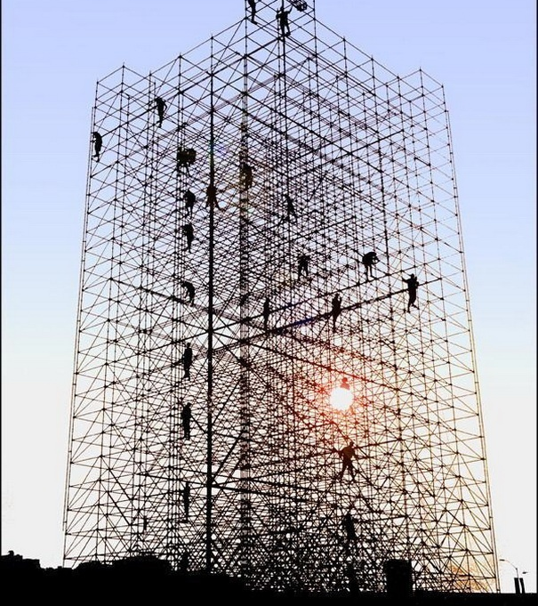
POSSIBLE PERILS!
In one case study, the instructor gave explicit instructions -
“Use this as the author, title,” etc.
- and students still did not follow instructions. Why not?
(Macbeth, 2006)
This Photo by Unknown Author is licensed under CC BY-SA

Slide 71
SOME REASONS STUDENTS DO NOT FOLLOW WHAT WE MAY CONSIDER CLEAR DIRECTIVES:
Cognitive load – too much information at once
Timing – didn’t need that information at the moment it was given and didn’t have that information when it was needed
Simply didn’t understand instructions or didn’t understand enough about the assignment at the time to make use of the instructions (needed more context to make sense of directions)
Instructions didn’t fit into the student’s schema of correct writing so it was discarded.

Slide 72
EXPLAIN HOW TO USE SCAFFOLDING ACTIVITIES
In some case studies, the students did not use the scaffolding that they created and the instructor commented on.
In one example, the students wrote and revised thesis statements that they then did not use in their final papers.
One student thought it would be plagiarism to re-use the thesis statement (Macbeth, 2006).
Be explicit and tell students to use the scaffolding in the culminating assignment!

Slide 73
SCAFFOLDING – A REPRISE.
Brainstorming
Modeling
Sample papers
Analyzing flawed and proficient texts
Process approach /drafting
Demonstrating composition process
Co-constructing
Giving language
“Process” or task specific mini-assignments
Outlining

Slide 74
FINAL TIPS FOR SCAFFOLDING
Be creative.
Be specific -
Make the scaffolding specific to your assignment.
Ask for specific tasks that can be later incorporated into the culminating assignment.
Be explicit in instructing students how to use the scaffolding assignments.

Slide 75
FEEL FREE TO CONTACT US.
Linda Weaver
The College of Wooster
Culture, Academics, and Language Consultant
E-mail Address: lweaver@wooster.edu
Office Phone: (330) 263-2428
APEX - The Learning Center, Office 044A
Address: : The College of Wooster
APEX - The Learning Center
1140 Beall Avenue
Wooster, Ohio 44691
Carla Reyes, MATESL
The College of Wooster
Assistant Director, Learning Center
E-mail Address: creyes@wooster.edu
Office Phone: (330) 263-2267
APEX - The Learning Center, Office
Address: The College of Wooster
APEX - The Learning Center
1140 Beall Avenue
Wooster, Ohio 44691
L

